Slide 1
HTCS 6704 Assignment 1: Case Study
By Luis Suarez, Akshay Pragji, Young Kwang Kweon

Slide 2
Introduction
Cybersecurity as a Strategic Risk.
2023 Latitude Financial breach – 14M records exposed
Revealed poor data governance & excessive retention
Harm to customers, reputation, and trust
ESRM model applied to strengthen enterprise resilience

Slide 3

Overview of ESRM Enterprise Security Risk Management
What is ESRM ?
Aligns system security with business objectives.
Requires cyber professionals and stakeholders to work together.
Latitude Finance

Slide 4

ESRM Pillars
Risk based approach
Stakeholder engagement
Continuous improvement & transparency
Data driven decision making
Governance

Slide 5
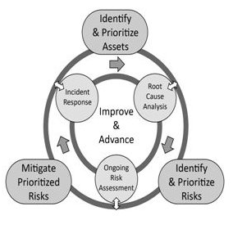
ESRM Life Cycle​

Slide 6

ESRM Principals
Holistic View
Transparency
Goals

Slide 7

ESRM Benefits
Compliance
Accountability
Improved decision making
Strategic alignment
Regulatory compliance
Protects brand
Builds customer trust
Builds culture of cyber awareness

Slide 8

Implementing ESRM
Applying ESRM lifecycle to scenario
ESRM Steps:
Identify and Prioritise assets
Identify and Prioritise security risks
Mitigate prioritised risks
Continuous Improvement

Slide 9


Identify and Prioritise assets
Resources that must be protected to achieve organisational objectives
Assets can be:
Data
Device
People
Facility
Process
Reputation
computer systems
Property
Service providers
Priority | Assets
1 | Customer Personal Information
2 | Customer Trust and Reputation
3 | Regulatory and Legal Compliance
4 | Operational IT Systems
5 | Employees or Insiders

Slide 10

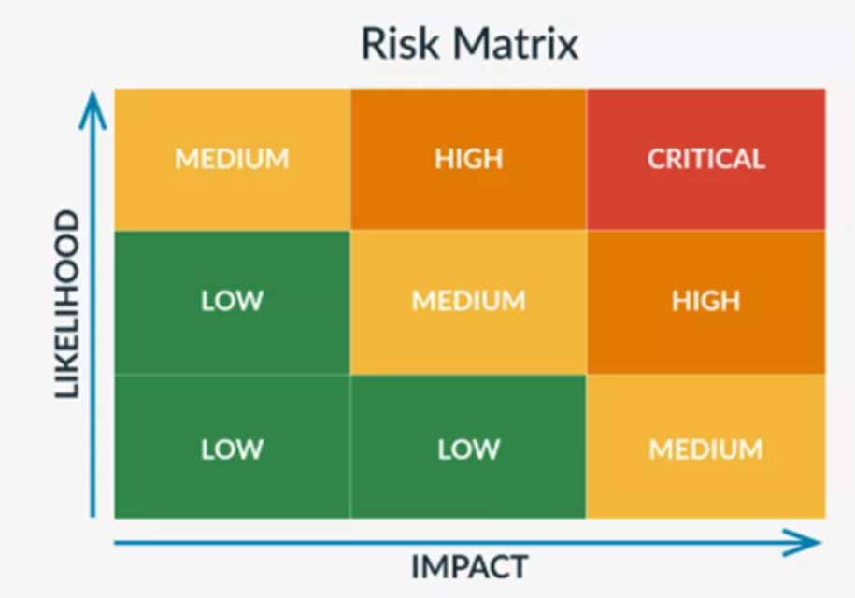
Identify and Prioritise security risks
To identify threats and vulnerabilities that could harm assets
Prioritised by Likelihood X Impact:
Priority | Risk | Asset involved
1 | Excessive data retention | Customer Personal Information
2 | External Cyberattack | Customer Trust and Reputation
3 | Reputational Damage and Loss of Customer Trust | Regulatory and Legal Compliance
4 | Regulatory non-compliance | Operational IT Systems
5 | Operational disruption | Employees or Insiders

Slide 11


Mitigate prioritised risks
Risk | Mitigation Strategy
Excessive data retention | Data minimisation Encryption
External Cyberattack | MFA, Least Privilege Regular patching SIEM deployment
Reputational Damage and Loss of Customer Trust | Crisis communication plan with customers and regulators Credit monitoring Publish reports
Regulatory non-compliance | Data Protection Officer Annual compliance audits Staff training on obligations
Operational disruption | Implement recovery plan Regular backups
To design and implement controls and strategies that reduce the likelihood and impact of the most critical risks
Risk treatment strategies:
Mitigate
Accept
Transfer
Avoid

Slide 12

Continuous Improvement
Continuous monitoring and reporting
To ensure risk management is an ongoing cycle, not a one-time exercise
To adapt to new threats, technologies, and regulatory changes
Risk | Monitoring strategy
Excessive data retention | Annual retention audits Board reporting on data minimisation
External Cyberattack | Monthly penetration tests SOC reports to executives
Reputational Damage and Loss of Customer Trust | Post-incident surveys Stakeholder feedback
Regulatory non-compliance | Quarterly compliance reports Regulator engagement
Operational disruption | Recovery time objectives measured and reviewed after each test

Slide 13

Applying Ethical Practices
Linking Ethics with Legal Obligations
Privacy Act 2020 → Retention, minimisation, transparency
ESRM requires going beyond compliance
Ethical culture = long-term trust and resilience

Slide 14
Findings
Weak data retention policy and governance
Inadequate monitoring
Slow response

Slide 15
Recommendations
Data retention policy
Continuous monitoring of threats
Quantitative data analysis
Collaboration
Incident response plan
Transparency
Use ethics in decision making
Audit
Strong security culture
Improve customer trust, reputation and brand

Slide 16
References
Alert Media. (2025, February 27). Enterprise Security Risk Management (ESRM): A Strategic Framework for Modern Security Leaders. Retrieved from www.alertmedia.com: https://www.alertmedia.com/blog/enterprise-security-risk-management/#:~:text=Key%20Risk%20Management%20Principles%20for%20Effective%20ESRM&text=It%20focuses%20on%20four%20key,data-driven%20de
Barrett, J. (2023, March 27). Latitude Financial cyber-attack worse than first thought with 14m customer records stolen. Retrieved from www.theguardian.com: https://www.theguardian.com/australia-news/2023/mar/27/latitude-financial-cyber-data-breach-hack-14m-customer-records-stolen#:~:text=after%20newsletter%20promotion,for%20remediation%2C%E2%80%9D%20Latitude%20said.
CISCO. (2023, March). Cisco Cybersecurity Readiness Index Report. Retrieved from www.cisco.com: https://www.cisco.com/c/dam/m/en_us/products/security/cybersecurity-reports/cybersecurity-readiness-index/2023/cybersecurity-readiness-index-report.pdf
European Union Agency for Cybersecurity (ENISA). (2021). Data Protection Engineering. ENISA. https://www.enisa.europa.eu
HYPERPROOF TEAM. (2025, February 5). Risk Management Techniques: Understanding Different Approaches and How to Apply Them. Retrieved from https://hyperproof.io/resource/risk-management-techniques/
Institute of Directors New Zealand. (2022). Director Sentiment Survey Report 2022. Institute of Directors. Retrieved from https://www.iod.org.nz/resources-and-insights/research-and-analysis/director-sentiment-survey-report-2022/
IT Professionals New Zealand. (2021). ITP Code of Ethics. IT Professionals NZ. Retrieved from https://itp.nz/Members/Code-of-Ethics
Kollmorgen, A. (2023, May 10). www.choice.com.au. Retrieved from Latitude Finance breach affecting customers of many current and former businesses: https://www.choice.com.au/data-protection-and-privacy/protecting-your-data/data-privacy-and-safety/articles/latitude-finance-data-breach
Meyer, C. (2023, September 18). Meet the 3 Key Roles Within ESRM. Retrieved from www.asisonline.org: https://www.asisonline.org/security-management-magazine/articles/2023/09/esrm/key-roles-esrm/
Office of the Privacy Commissioner NZ. (2023, April 3). New Zealand’s biggest data breach shows retention is the sleeping giant of data security. Retrieved from https://www.privacy.org.nz
Parliament of New Zealand. (2020). Privacy Act 2020. Public Act 2020 No 31. Retrieved from https://www.legislation.govt.nz
Stock, R. (2023, June 18). Three months after Latitude cyberattack, some victims still not notified. Retrieved from www.rnz.co.nz: https://www.rnz.co.nz/news/national/492222/three-months-after-latitude-cyberattack-some-victims-still-not-notified
Sunarso, E. (2019, October 20). Enterprise Security Risk Management (ESRM). Retrieved from www.linkedin.com: https://www.linkedin.com/pulse/enterprise-security-risk-management-esrm-endro-sunarso/
Vaughan, G. (2023, March 27). Latitude Financial says millions of driver's license details & details from tens of thousands of passports pilfered in cyber-attack. Retrieved from www.interest.co.nz: https://www.interest.co.nz/personal-finance/120499/latitude-financial-says-millions-drivers-licence-details-tens-thousands#:~:text=by%20ShoreThing%20%7C%2027th%20Mar%2023,27th%20Mar%2023%2C%201:54pm

